Slide 1
The PHP Performance Paradox
Zeev Suraski
Co-founder & CTO
Zend Technologies

Slide 2
Quick Recap of ZendCon news

Slide 3
Business Use of PHP Continues to Increase
General Electric

Slide 5
Key Drivers to Growth: Developer Affinity and Strong Application Ecosystem
Developer’s Affinity
Applications Ecosystem

Slide 6
Zend Framework 1.11
New Mobile Support
Mobile is big
Fabrique en France!
Et en Italie et les Etats Unis…
Simple Cloud GA

Slide 7
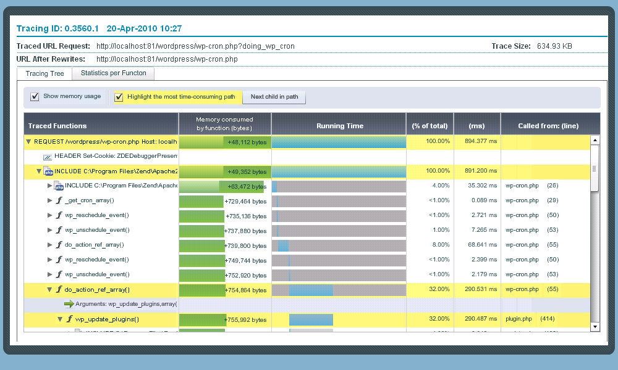
Zend Updates
Zend Studio 8
Much improved performance
Virtualization & cloud support
Ajax support
Zend Server AMI on EC2
Zend Server Code Tracing

Slide 8
Getting back to Performance…

Slide 9
PHP’s Performance Evolution
Lower is better

Slide 10
OO performance improvements in PHP 5.x
Lower is better

Slide 11
PHP 3.0
Released: June 1998
New Features:
Full-fledged language
First OO model
Modularity
Performance Features
Token Cache (!)
Memory Manager

Slide 12
PHP 3.0 In Perspective
Lower is better

Slide 13
PHP 4.0
Released: May 2000
New Features:
Downwards Compatibility (!)
Sessions
More modularity
Performance Features
Zend Engine – compilation introduced!
Pluggable Performance Enhancers

Slide 14
PHP 5.0
Released: July 2004
New Features:
New ‘true’ object model
Exception Handling
Type hinting
Performance Features
Call threaded VM

Slide 15
PHP 5.1
Released: November 2005
New Features:
Array type hinting
Class constants and static members of internal classes
Performance Features
New FastCGI SAPI
Specialized Executor
Compiled variables

Slide 16
In-depth: Specialized Executor
int zend_add_handler()
{
add_function(
&EX_T(opline->result.u.var).tmp_var,
get_zval_ptr(
&opline->op1, EX(Ts),
&EG(free_op1), BP_VAR_R),
get_zval_ptr(
&opline->op2, EX(Ts),
&EG(free_op2) BP_VAR_R)
TSRMLS_CC);
FREE_OP(
EX(Ts),
&opline->op1,
EG(free_op1));
FREE_OP(
EX(Ts),
&opline->op2,
EG(free_op2));
NEXT_OPCODE();
}
ZEND_VM_HANDLER(1, ZEND_ADD,
CONST|TMP|VAR|CV,
CONST|TMP|VAR|CV)
{
zend_op *opline = EX(opline);
zend_free_op free_op1, free_op2;
add_function(
&EX_T(opline->result.u.var).tmp_var,
GET_OP1_ZVAL_PTR(BP_VAR_R),
GET_OP2_ZVAL_PTR(BP_VAR_R)
TSRMLS_CC);
FREE_OP1();
FREE_OP2();
ZEND_VM_NEXT_OPCODE();
}

Slide 17
In-depth: Specialized Executor
int ZEND_ADD_SPEC_CONST_CV_HANDLER()
{
zend_op *opline = EX(opline);
add_function(
&EX_T(opline->result.u.var).tmp_var,
&opline->op1.u.constant,
_get_zval_ptr_cv(
&opline->op2, EX(Ts),
BP_VAR_R TSRMLS_CC)
TSRMLS_CC);
ZEND_VM_NEXT_OPCODE();
}
ZEND_VM_HANDLER(1, ZEND_ADD,
CONST|TMP|VAR|CV,
CONST|TMP|VAR|CV)
{
zend_op *opline = EX(opline);
zend_free_op free_op1, free_op2;
add_function(
&EX_T(opline->result.u.var).tmp_var,
GET_OP1_ZVAL_PTR(BP_VAR_R),
GET_OP2_ZVAL_PTR(BP_VAR_R)
TSRMLS_CC);
FREE_OP1();
FREE_OP2();
ZEND_VM_NEXT_OPCODE();
}

Slide 18
In-depth: Compiled Variables
<?php
function add($a, $b) {
$c = $a + $b;
return $c;
}
FETCH_W “a” -> var(0)
RECV 1, var(0)
FETCH_W “b” -> var(1)
RECV 2, var(1)
FETCH_R “a” -> var(2)
FETCH_R “b” -> var(3)
ADD var(2), var(3) -> tmp(4)
FETCH_W “c” -> var(5)
ASSIGN var(5), tmp(4)
FETCH_R “c” -> var(6)
RETURN var(6)
11 instructions
6 hash look-ups
3 hash insertions
RECV 1, cv(0,“a”)
RECV 2, cv(1,“b”)
ADD cv(0,”a”), cv(1,”b”) -> tmp(0)
ASSIGN cv(2,”c”), tmp(0)
RETURN cv(2,“c”);
5 instructions
3 quick hash look-ups
3 quick hash insertions

Slide 19
PHP 5.2
Released: November 2006
New Features:
Many extension improvements
Performance Features
New Memory Manager
Optimized compilation of “” strings and HEREDOCs

Slide 20
PHP 5.3
Released: June 2009
New Features:
Namespaces, Closures
Late static binding, limited goto, NOWDOC
Performance Features
Garbage Collector
Segmented VM stack
Stackless VM
Compiletime Constants Substitution
Lazy symtable initialization
Improved realpath cache

Slide 21
In-depth: Lazy Symbol Table Initialization
<?php
function add($a, $b) {
$c = $a + $b;
return $c;
}
FETCH_W “a” -> var(0)
RECV 1, var(0)
FETCH_W “b” -> var(1)
RECV 2, var(1)
FETCH_R “a” -> var(2)
FETCH_R “b” -> var(3)
ADD var(2), var(3) -> tmp(4)
FETCH_W “c” -> var(5)
ASSIGN var(5), tmp(4)
FETCH_R “c” -> var(6)
RETURN var(6)
11 instructions
6 hash look-ups
3 hash insertions
RECV 1, cv(0,“a”)
RECV 2, cv(1,“b”)
ADD cv(0,”a”), cv(1,”b”) -> tmp(0)
ASSIGN cv(2,”c”), tmp(0)
RETURN cv(2,“c”);
5 instructions
3 quick hash look-ups
3 quick hash insertions

Slide 22
In-depth: Lazy Symbol Table Initialization
<?php
function add($a, $b) {
$c = $a + $b;
return $c;
}
FETCH_W “a” -> var(0)
RECV 1, var(0)
FETCH_W “b” -> var(1)
RECV 2, var(1)
FETCH_R “a” -> var(2)
FETCH_R “b” -> var(3)
ADD var(2), var(3) -> tmp(4)
FETCH_W “c” -> var(5)
ASSIGN var(5), tmp(4)
FETCH_R “c” -> var(6)
RETURN var(6)
11 instructions
6 hash look-ups
3 hash insertions
RECV 1, cv(0,“a”)
RECV 2, cv(1,“b”)
ADD cv(0,”a”), cv(1,”b”) -> tmp(0)
ASSIGN cv(2,”c”), tmp(0)
RETURN cv(2,“c”);
5 instructions
0 quick hash look-ups
0 quick hash insertions

Slide 23
Lazy Symbol Table Initialization Considerations
For highly performance-sensitive functions, avoid:
Avoid indirect reference ($$a)
eval() and include()
Functions that access the symbol table directly (parse_str(), extract(), etc.)
All good ideas regardless, but also trigger initialization of the function symbol table

Slide 24
PHP trunk (probably 5.4)
Released: TBD
New Features:
Traits
Array dereferencing – foo()[]
Performance Features
Delayed hashtable allocation
Literal Tables
Runtime binding cache
Interned Strings
Reduced memory consumption
Startup/shutdown optimization

Slide 25
In depth: Interned Strings
Store only one copy of each distinct string
Compare pointers instead of using strcmp()
Eliminate string copying
Store pre-computed hash_value
Caveat:
Only works with strings known at compile-time

Slide 26
Lies, damn lies & benchmarks

Slide 27
Real World Benchmark: Hello World
Notes:
So that's all about the improvements we did and now I'd like to show you how they affects real-life applications
I'll show a series of slides to show the effect of the optimizations on different applications
On the left side you'll see benchmark results of vanilla PHP and on the right PHP with O+ as an opcode cache
All the benchmark results were collected on the same hardware and the same web server with FastCGI SAPI
The first one just a „hello world“
A big improvement in 5.0 is caused by usage of UNIX sockets for FastCGI protocol
5.1 implemented a new FastCGI implementation
5.2 and 5.3 worked even worse than 5.1 because of new language features and more complex request startup/shutdown sequences
Trunk benefits from the request startup/shutdown optimization and FastCGI improvements
O+ makes just a very small speedup, because compilation of a single line script doesn't take a lot of time
s

Slide 28
Real World Benchmark: QDIG
Notes:
Qdig is a small image gallery script which performs a lot file operations
Surprisingly it got the most visible improvement from 5.2 and it's probably caused by the new memory manager
O+ makes less than 2 times improvement, because the application size is still small

Slide 29
Real World Benchmark: Drupal
Notes:
Drupal is a well known context managing system with excellent multilevel content caching
5.2 made it faster because of the new memory manager
5.3 made it faster too, but only without O+, that means that it benefits from new re2c scanner. It improves compilation speed, but it's not so important in production.
O+ makes significant speedup because the application itself is fast, and its compilation takes significant part of the whole request processing
Interesting that HipHop achieves 1045 req/sec that is even worse than php5.2

Slide 30
Real World Benchmark: Wordpress
Notes:
Wordpress is another well known non OO blog engine
Again 5.2 makes it run faster because of the new memory manager
5.3 speedups the compilation process
And trunk shows the advantage of the interned strings and the run-time binding caches
On this test HipHop made 112 req/sec, and it is comparable with speed of php trunk

Slide 31
Real World Benchmark: XOOPS
Notes:
XOOPS is a OO CMS
It shows near the same picture as wordpress, except for trunk, where speedup became a bit more significant, because OO operations became significantly faster with the run-time binding caches

Slide 32
Real World Benchmark: Zend Framework
Notes:
Right now it's not a real-life application it's just a test which load most of ZF classes
As usually 5.3 has the fastest compiler, it's even faster than in trunk because there we have to care about interned strings and cache slots
But with O+ trunk became significantly faster because of less memory usage
As you see O+ makes a huge speedup, because application does nothing special except for including a lot of files

Slide 33
Real World Benchmark: Scrum (ZF)
Notes:
Finally scrum. It's a ZF based reference application.
It performs XML parsing, DB queries and regular expression matching
But anyway it shows pattern very similar to ZF itself.
Of course O+ doesn't make such significant speed improvement because application does a real work

Slide 34
How do we fare? Mandelbrot in different languages

Slide 35
Going Forward

Slide 36
JIT may be coming to PHP!
RECV 1, cv(0,“a”)
RECV 2, cv(1,“b”)
ADD cv(0,”a”), cv(1,”b”) -> tmp(0)
ASSIGN cv(2,”c”), tmp(0)
RETURN cv(2,“c”);
push %esi
mov %ecx, %esi
call ZEND_RECV
mov %esi, %ecx
call ZEND_RECV
mov %esi, %ecx
call ZEND_ADD_SPEC_CV_CV
mov %esi, %ecx
call ZEND_ASSIGN_SPEC_CV_TMP
mov %esi, %ecx
call RETURN_SPEC_CV
pop %esi
ret

Slide 37
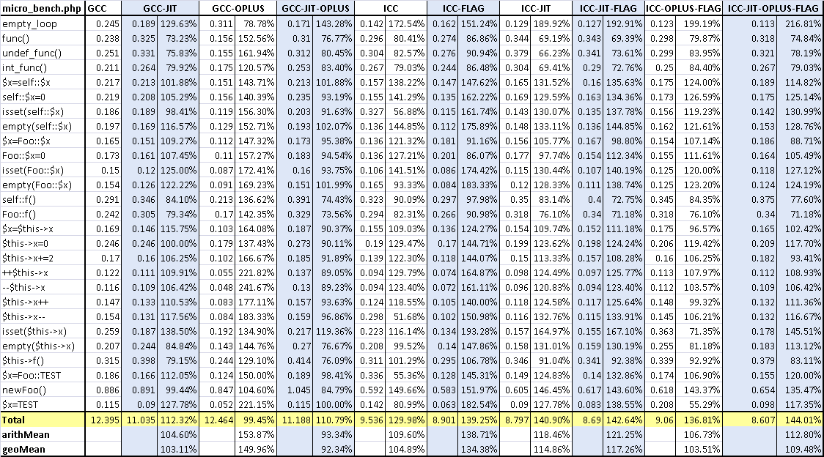
Using ICC

Slide 38
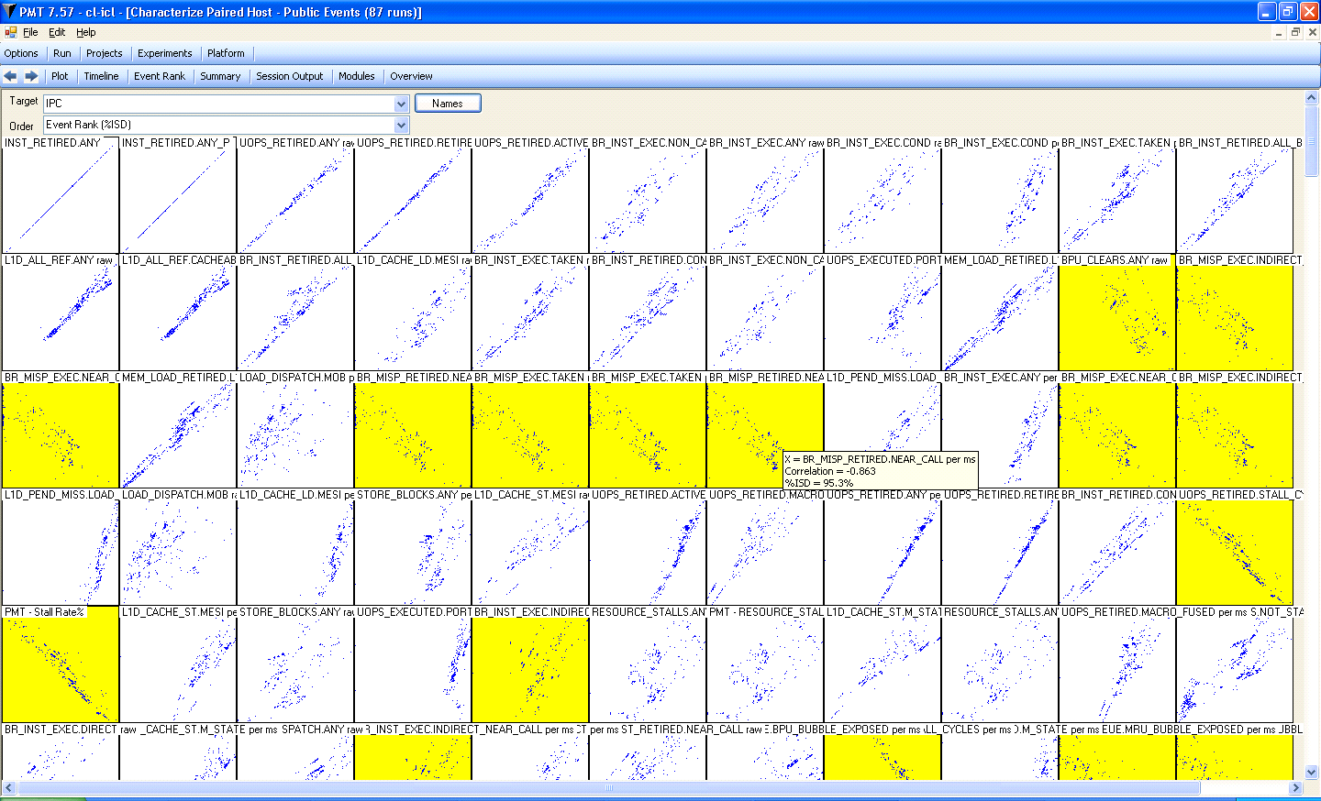
Asking for Van-Gogh’s help (Low level tuning)

Slide 39
Merci!

